Slide 1


SOCIAL BUZZ

Slide 2


Today's agenda
Project recap
Problem
The Analytics team
Process
Insights
Summary

Slide 3

Social Buzz is a fast growing technology unicorn that needs to adapt quickly to its global scale. With the help of Accenture’s consulting services it aims to solve these problems
An audit of their big data practice
Recommendations for a successful IPO
An analysis of their content categories that highlights the top 5 categories with the largest aggregate popularity
Project Recap

Slide 4

Problem
Over 100,000 posts per day
36,500,000 pieces of content every year
Find the top 5 categories of content from this data

Slide 5



Andrew Fleming Chief Technical Architect
The Analytics team
Marcus Rompton
Senior Principle
Shreyas
Data Analyst

Slide 6
Process
1
Data Understanding
2
Data Cleaning
3
Data Modelling
4
Data Analysis
5
Uncover Insights

Slide 7
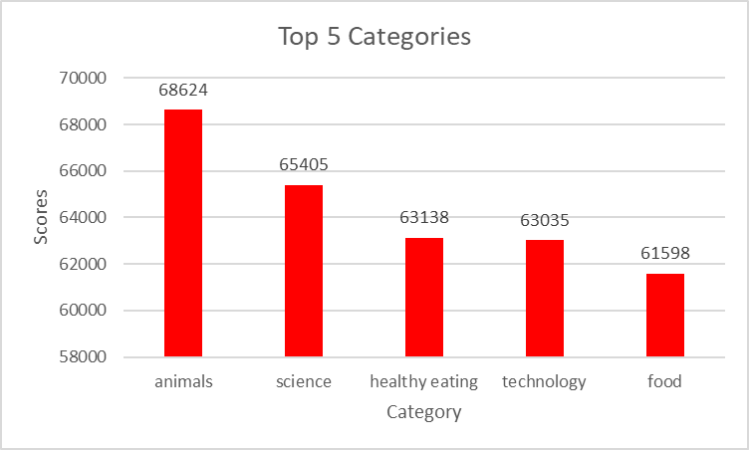

Insights
The top 5 categories with the highest scores are as follows:
Animals: 68624
Science: 65405
Healthy Eating : 63138
Technology: 63035
Food: 61598

Slide 8
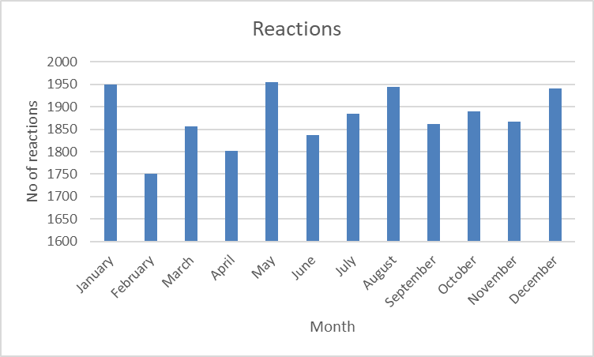
Most number of reactions are made in the months of January, May, August and December
The least number of reactions are in the month February

Slide 9
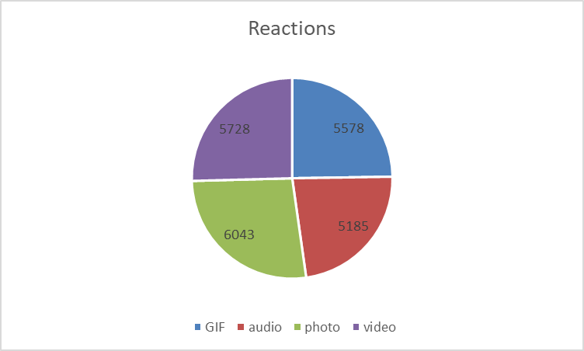
Photos have the most reactions followed by videos then GIFs and the least number of reactions are for audio

Slide 10

Animals category has the highest score
Summary
May month has the most reactions
Photos have the most reactions

Slide 11
Thank you!
ANY QUESTIONS?

